Slide 1
CS513- KNOWLEDGE DISCOVERY & DATA MINING
Credit Card Fraud Detection

Slide 2
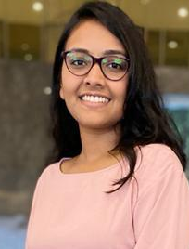
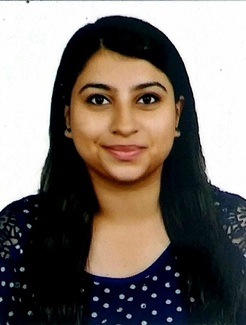


Team Members
Krina Uday Shah
CWID: 10459200
Riya Rajan Kale CWID: 20008491
Udit Pravinbhai Patel
CWID: 20006998
Varun Reddy Doddipalli
CWID: 10474196

Slide 3
Today’s Agenda
Discussion of Dataset
Problem Statement / Objective
Overview of Classification Techniques
EDA & Correlation Heatmap
Detailed Classification/Clustering Analysis
Conclusions

Slide 4
Credit Card Fraud Detection Dataset
The Data set has 284,808 Rows and 31 Columns. It contains only numeric input variables resulting from a PCA transformation. Unfortunately, the data does not include the original features and more background information about the data due to confidentiality issues. The task is to classify the credit card fraud of the customer. Some algorithms we will be implementing will be Logistics Regression, Decision Tree, Random Forest, XGBoost, KNN and ANN.
Variables | Description
Time | Number of seconds elapsed between this transaction and the first transaction in the dataset
V1-V28 | The result of a PCA Dimensionality reduction to protect user identities and sensitive features
Amount | Transaction amount
Class | 1 for fraudulent transactions, 0 otherwise

Slide 5
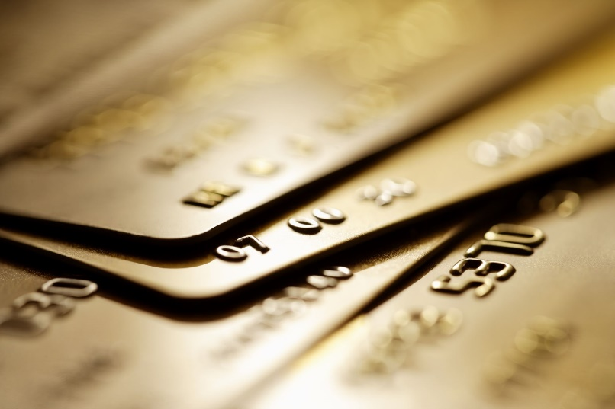
Problem Statement
Unauthorized card operations hit an astonishing amount of 16.7 million victims in 2017.
It's critical for credit card firms to be able to spot fraudulent credit card transactions so that customers aren't charged for things they didn't buy.
We will be detecting credit card frauds of customers using classification algorithms based on their information.
The dataset provided is the sum of all transactions of various users, hence we are developing a generic model instead of developing a personal for each profile.

Slide 6
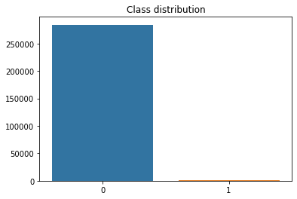
Class Distribution
So, as we can see that the dataset is imbalanced hence training this model on the imbalanced dataset would create a biased one.

Slide 7
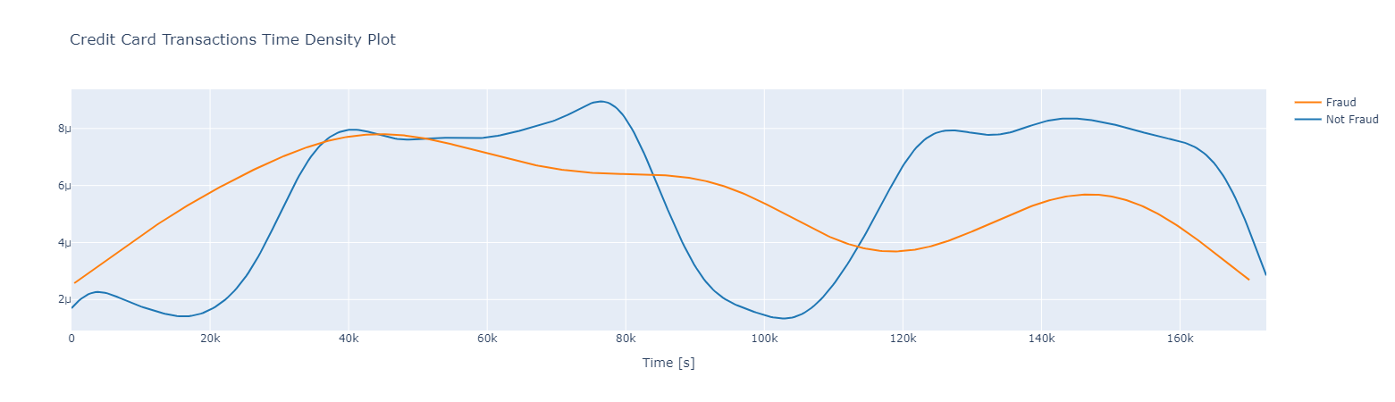
Credit card transaction time density plot
So, this Credit Card Transactions Time Density Plot visualizes the distribution of 'Not Fraud' and 'Fraud' transaction over a continuous interval of the time period

Slide 8
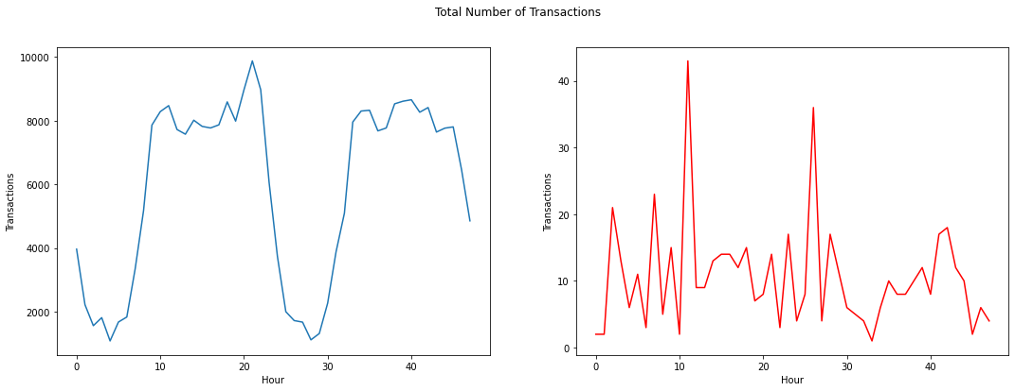
Total number of transactions against time
dwydu

Slide 9
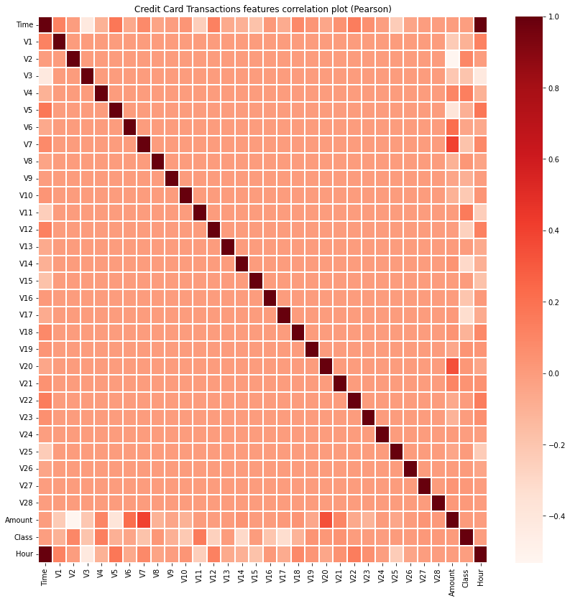
Correlation of the data points
As observed from the correlation graph, there is no attribute which has a higher dependency on deciding whether the transaction is fraudulent or not.

Slide 10
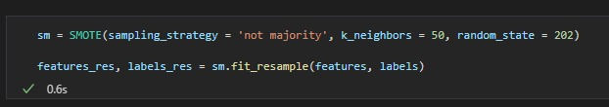
Up sampling – Smote
As we have seen in the class distribution slide, the model has more non-fraudulent transactions rather than fraudulent ones. So, to make a balanced dataset, we either have to downsample the data or over sample using some algorithms. Here we have chosen to implement SMOTE algorithm which works on KNN to create more fraudulent data points.

Slide 11

Different Models
Logistic Regression
Decision Tree
Random Forest
KNN
XGBoost
ANN

Slide 12
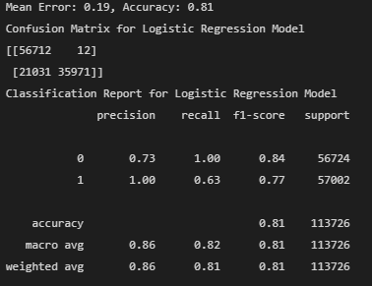
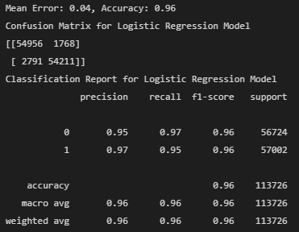
Logistic Regression
Model metrics trained on unbalanced dataset
Model metrics trained on balanced dataset

Slide 13
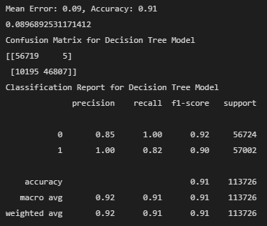
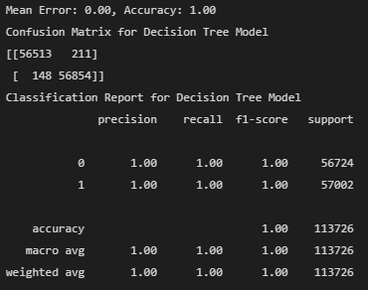
Decision Tree
Unbalanced dataset
Balanced dataset

Slide 14
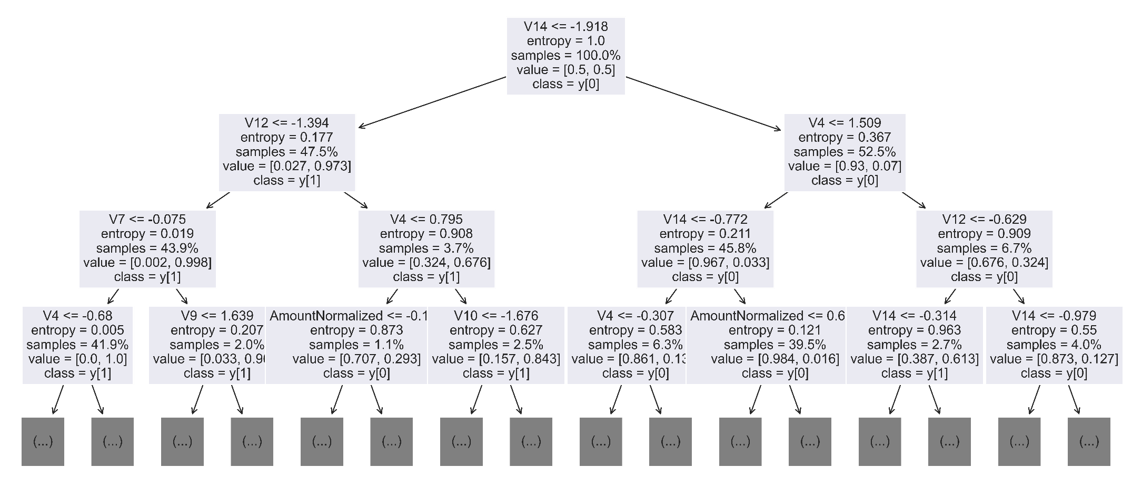
Decision Tree

Slide 15
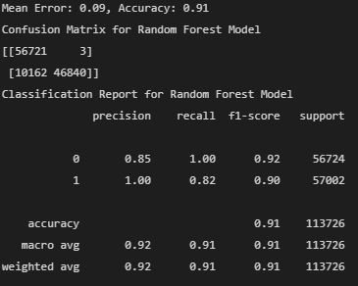
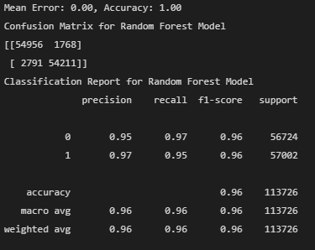
Random Forest
Unbalanced dataset
Balanced dataset

Slide 16
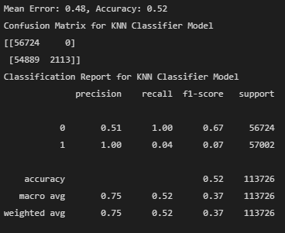

KNN
Unbalanced dataset
Balanced dataset

Slide 17
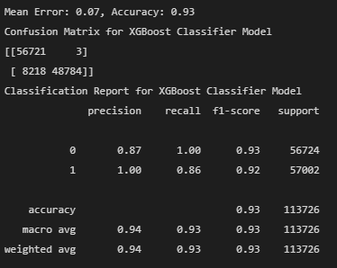
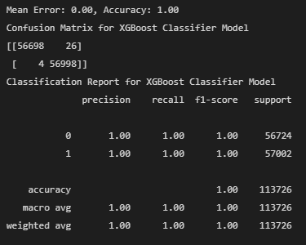
XGBoost
Unbalanced dataset
Balanced dataset

Slide 18
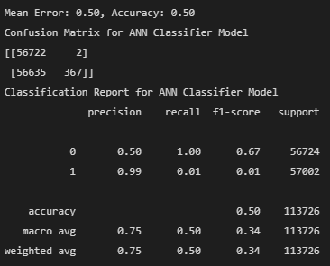

ANN
Unbalanced dataset
Balanced dataset

Slide 19
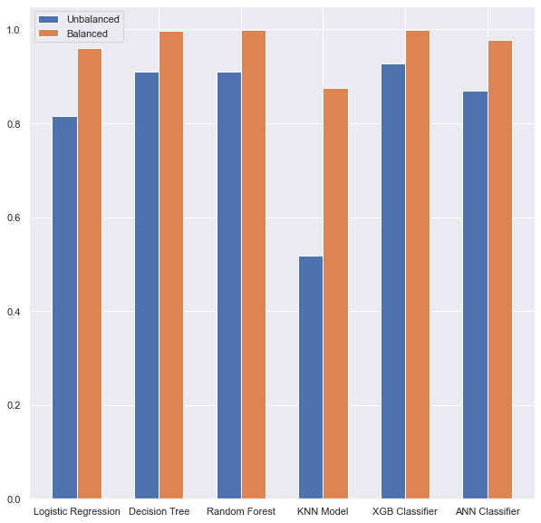
Comparison against various Models

